Slide 1


Team Details
Team name: The Pythonic Four
Team leader name: Yashraj Mishra
Problem Statement: A full-stack, QR code and geolocation-based attendance system that prevents proxy attendance by ensuring students are physically present within a faculty-defined classroom radius before marking attendance

Slide 2
Brief about your solution:
Our solution, Attendify, is a full-stack, geolocation-based attendance management system designed to completely eliminate proxy attendance in educational institutions. The core idea is simple yet powerful — a student can only mark their attendance if they are physically present in the classroom, and we enforce this through a dual-verification mechanism combining dynamic QR codes and real-time GPS validation.
Here's how it works: the faculty logs into their dashboard and creates an attendance session by capturing their live GPS coordinates and setting a proximity radius — say 50 meters. The system then generates a unique, session-specific QR code which the faculty projects on the classroom screen. Students open the app, scan the QR code, and the system simultaneously validates two things — first, that the QR token is valid and active, and second, that the student's live location falls within the defined radius. If either check fails, attendance is not marked. There is no way to mark attendance remotely.
On the management side, faculty can bulk upload student data via Excel, view live active sessions, and export attendance reports as CSV for records and analysis. Students get a clean dashboard to view their full attendance history. The entire system is secured with JWT-based authentication and BCrypt password hashing, ensuring data integrity and role-based access control throughout.
Built on a React + Node.js + SQLite stack, Attendify is lightweight, production-ready, and requires zero database configuration — making it easily deployable for any institution looking to modernize their attendance infrastructure.

Slide 3
Opportunities
How different is it from any of the other existing ideas?
How will it be able to solve the problem?
USP of the proposed solution
Most existing attendance systems — like biometric devices, RFID cards, or simple mobile check-ins — can be spoofed, shared, or operated remotely. Apps like Google Forms or basic QR attendance tools verify the QR but have no location enforcement, meaning a student can share a screenshot of the QR and a friend marks attendance from home. Biometric systems are hardware-dependent and expensive to install in every classroom. Attendify is different because it enforces simultaneous dual verification — a valid session token AND physical presence — without requiring any additional hardware. It runs entirely on a smartphone and a browser, making it zero-infrastructure and scalable.
Attendify tackles proxy attendance at its root by making it technically impossible to mark attendance without being present. The dynamic QR code changes with every session so old codes are useless. The geolocation check runs in real-time on the student's device and cross-validates with the faculty's set coordinates on the server. Even if a student shares the QR code with someone outside, that person cannot pass the location check from a different place. The faculty has complete visibility through live session tracking and downloadable reports, closing the loop on attendance integrity.
Attendify's biggest differentiator is its dual verification approach a student must simultaneously hold a valid QR session token AND be physically within the classroom's GPS radius to mark attendance. This makes proxy attendance **technically impossible**, not just discouraged. On top of that, it requires **zero additional hardware**, runs entirely on a smartphone, and is deployable in minutes — giving institutions enterprise-grade attendance security at virtually no infrastructure cost.

Slide 4
List of features offered by the solution
Geolocation-based attendance with custom classroom radius
Dynamic QR code generation per session
Dual verification — QR token + live GPS simultaneously
Faculty dashboard for session creation and management
One-click CSV export for attendance reports
Bulk student upload via Excel
Student portal with QR scanner and attendance history
JWT authentication with role-based access control
BCrypt password hashing for secure data storage
Auto-expiring session tokens to prevent QR reuse
Admin panel for platform-wide account management

Slide 5
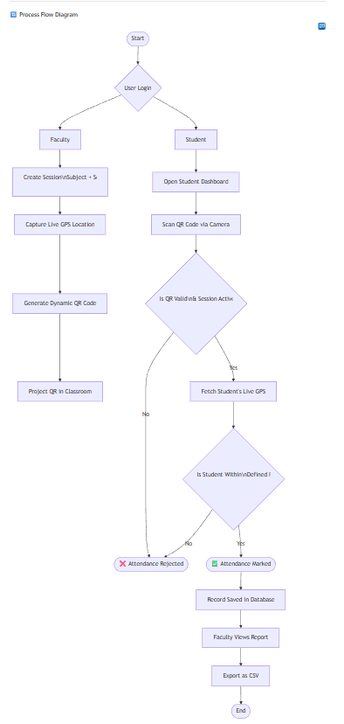
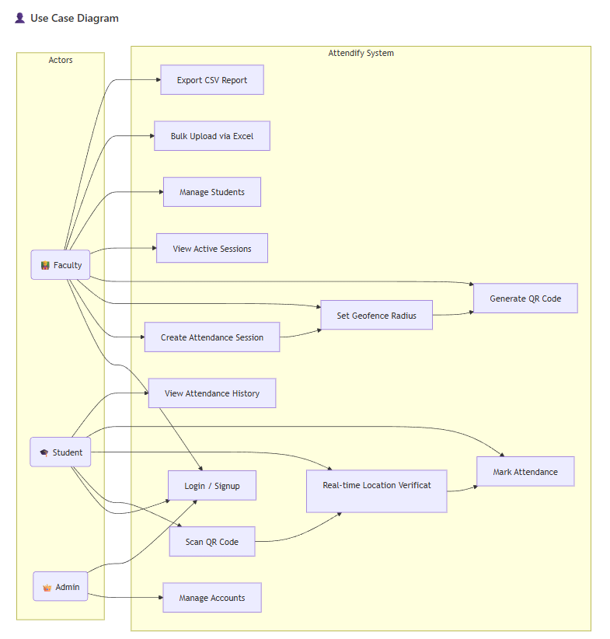
Process flow diagram or Use-case diagram

Slide 6
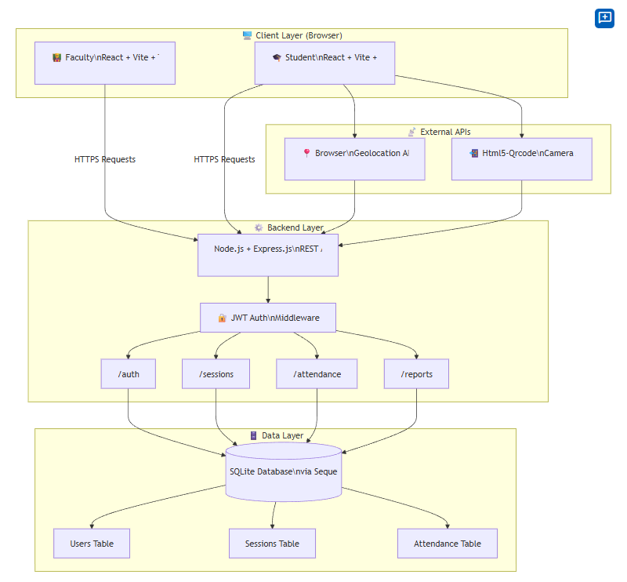
Architecture diagram of the proposed solution

Slide 7
Technologies to be used in the solution
React.js (Vite) — Frontend UI framework
Tailwind CSS — Responsive styling
Html5-Qrcode — In-browser QR code scanning
Node.js — Backend runtime environment
Express.js — REST API framework
SQLite + Sequelize ORM — Lightweight database
JWT — Secure user authentication
BCrypt — Password hashing & encryption
Browser Geolocation API — Real-time GPS tracking
Multer + XLSX — Excel file upload & parsing
Axios — Frontend-backend API communication
Render + Firebase — Backend & frontend deployment

Slide 8
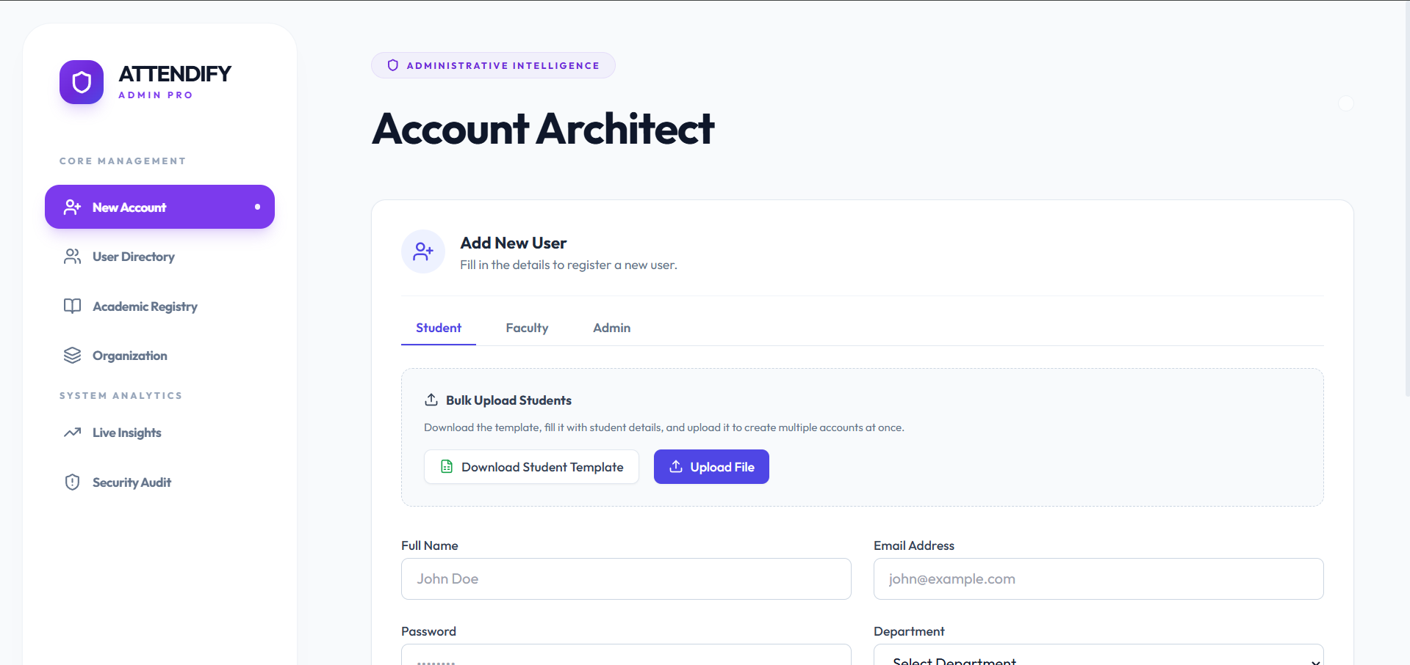
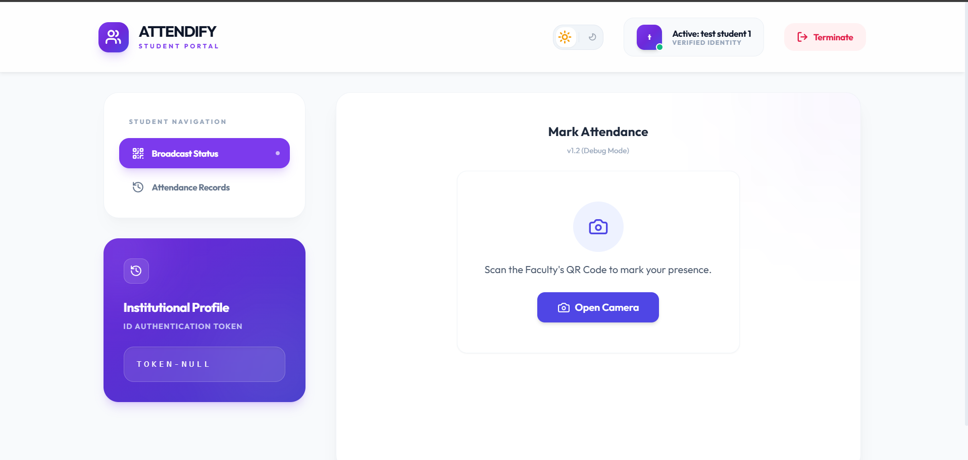
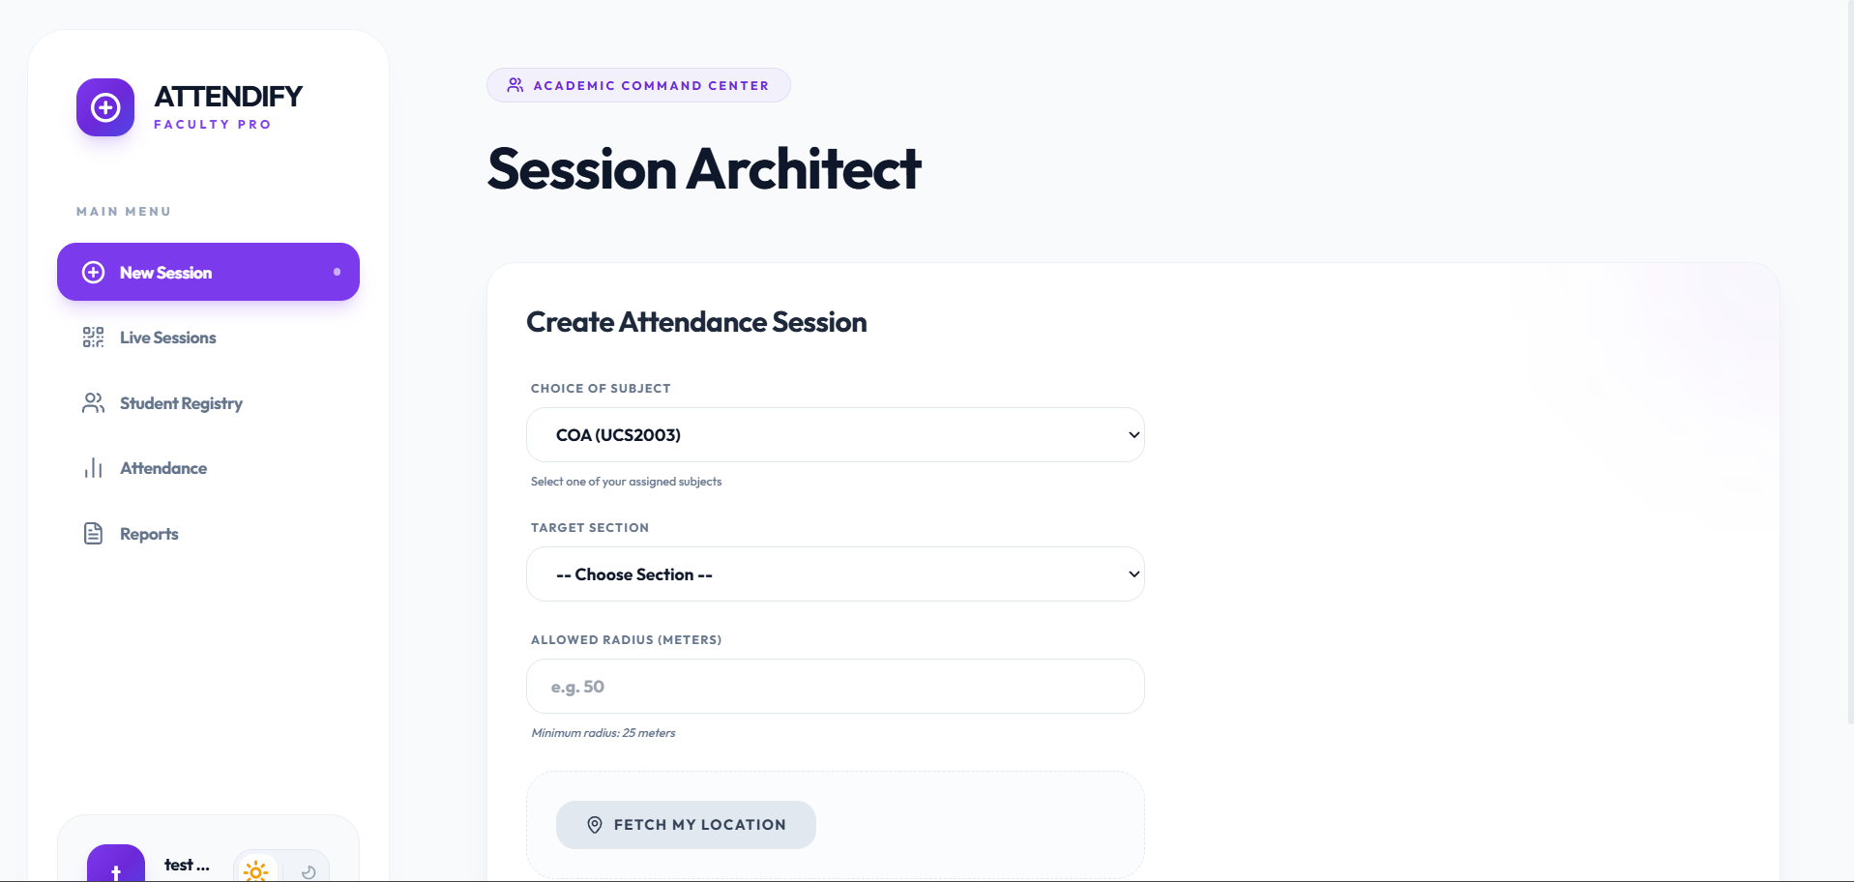
Snapshots of the MVP

Slide 9
Additional Details/Future Development (if any)
- Dedicated Android/iOS mobile app using React Native
- AI-based anomaly detection to flag suspicious attendance patterns
- Advanced analytics with trend graphs and performance heatmaps
- Push notifications for session alerts and low attendance warnings
- Multi-institution / multi-tenant support for multiple colleges
- Timetable integration for auto-session creation
- HOD-level dashboard for department-wide attendance overview
- Offline mode with sync when internet is restored
- ERP integration with university systems like Moodle/Fedena
- Automated weekly/monthly attendance email reports

Slide 10
Provide links to your:
GitHub Public Repository: https://github.com/Yashrajmshr/Attendify\
Demo Video Link (3 Minutes) https://drive.google.com/drive/folders/120uJqtLd2QWI41kzlT1hZPLyHIEO8w7u?dmr=1&ec=wgc-drive-%5Bmodule%5D-goto
MVP Link https://drive.google.com/drive/folders/120uJqtLd2QWI41kzlT1hZPLyHIEO8w7u?dmr=1&ec=wgc-drive-%5Bmodule%5D-goto
Working Prototype Link https://attendify-frontend-lh87.onrender.com/login For Admin Login Use: test_admin@gmail.com password: 1234
For Faculty Login Use: test_facult1@gmail.com
password: 1234
For Student Login use: test_student1@gmail.com
password: 1234

Slide 11


